Slide 1
Data Visualization
-Ashu Mehta
Database Systems

Slide 2
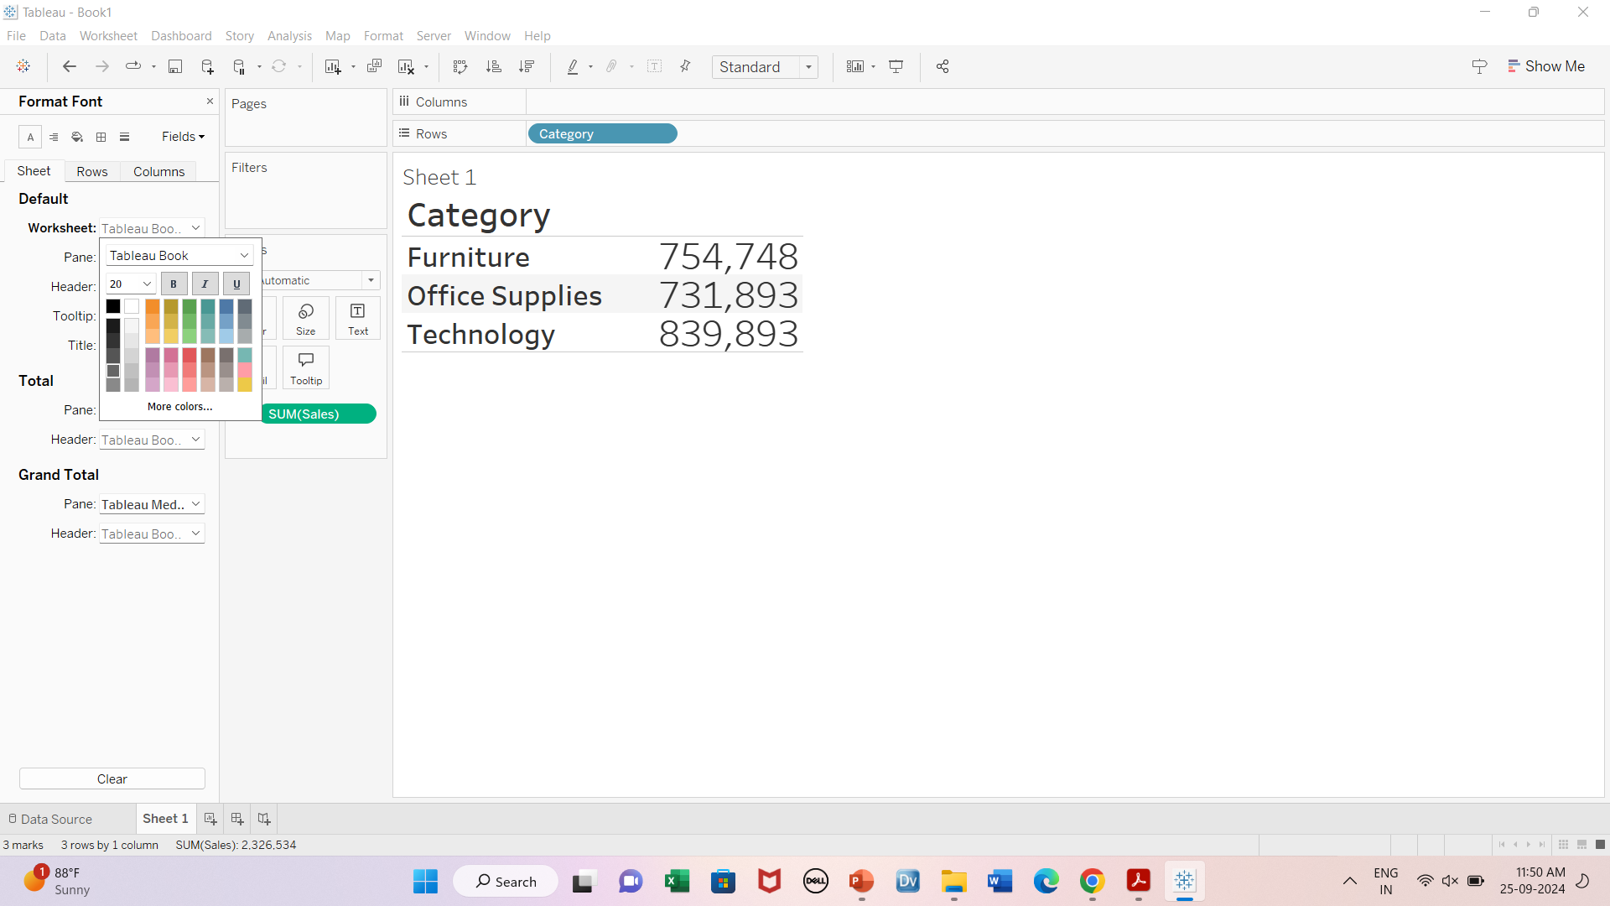



Format Option
Adjusting font size

Slide 3
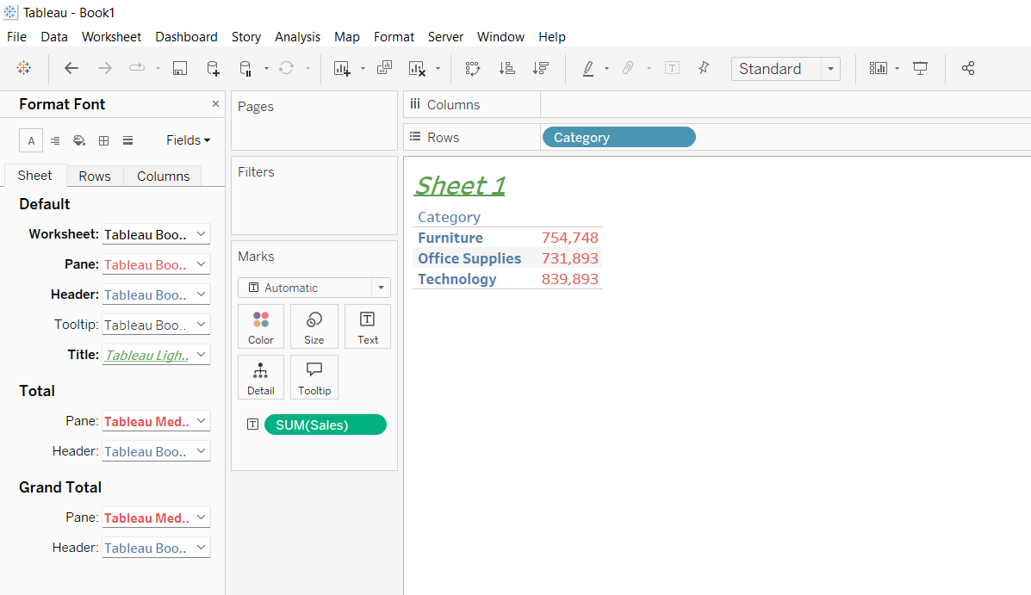

Pane, Header & Title formatting

Slide 4
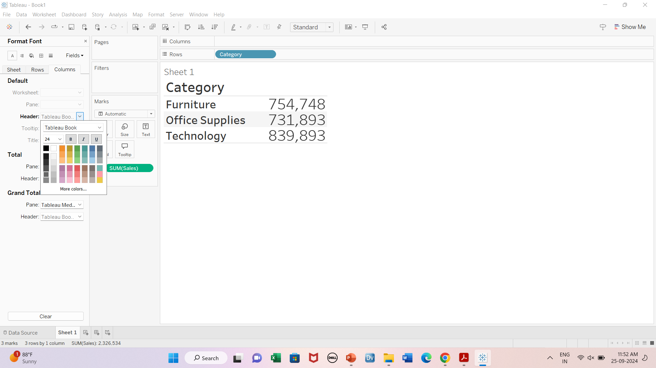

Adjusting header size

Slide 5
Marks card
Size
Color
Labels
Tooltip
Shapes
Detail

Slide 6
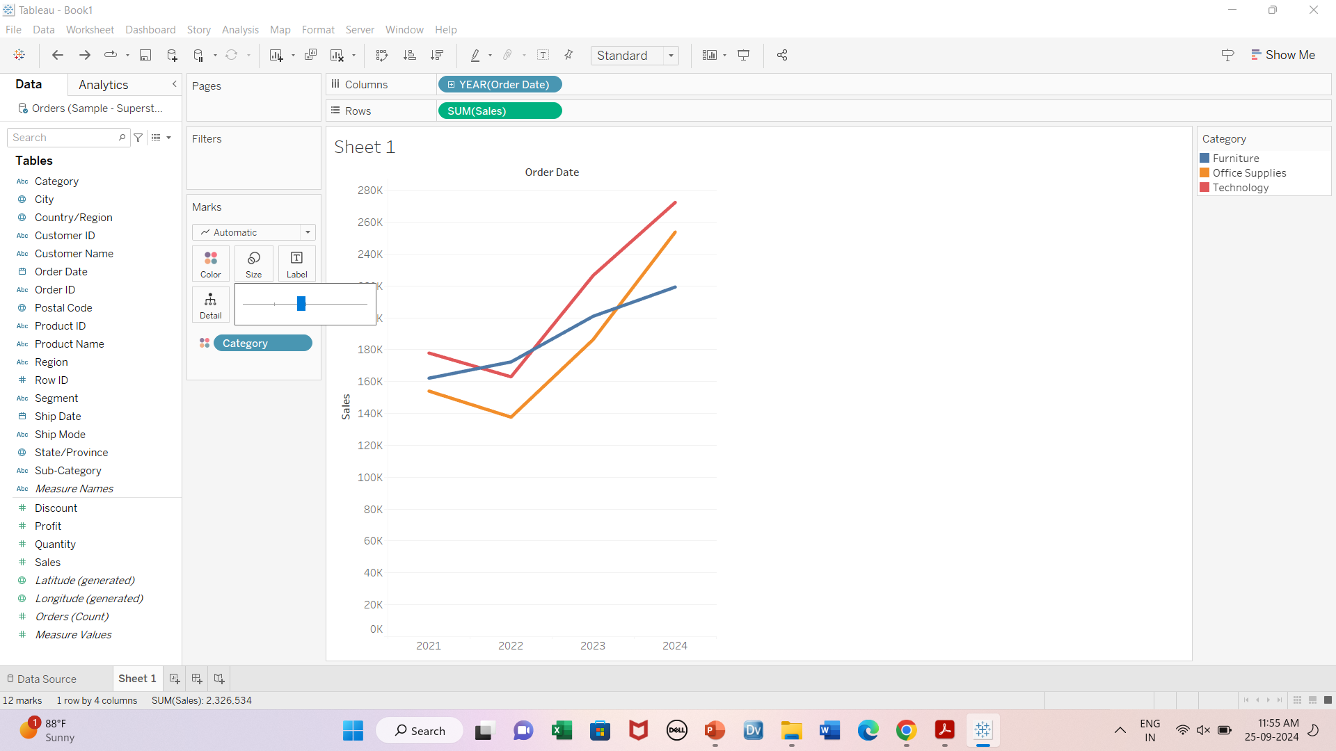

Size: Line chart

Slide 7
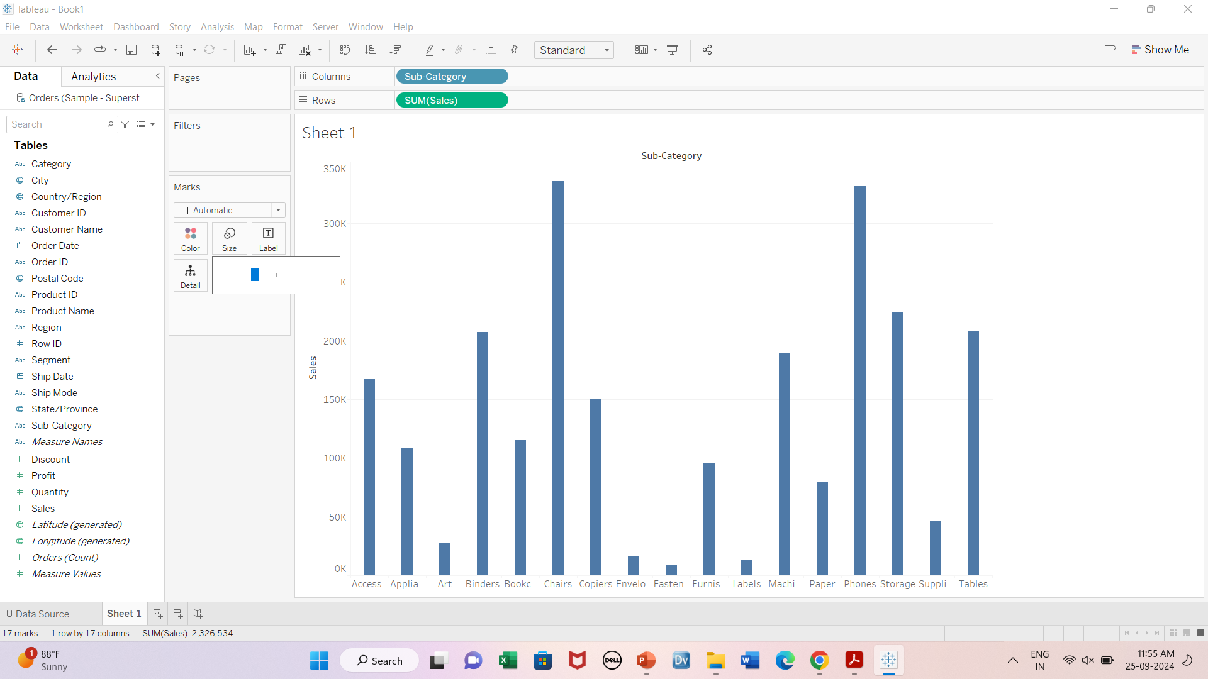

Size: Bar chart

Slide 8
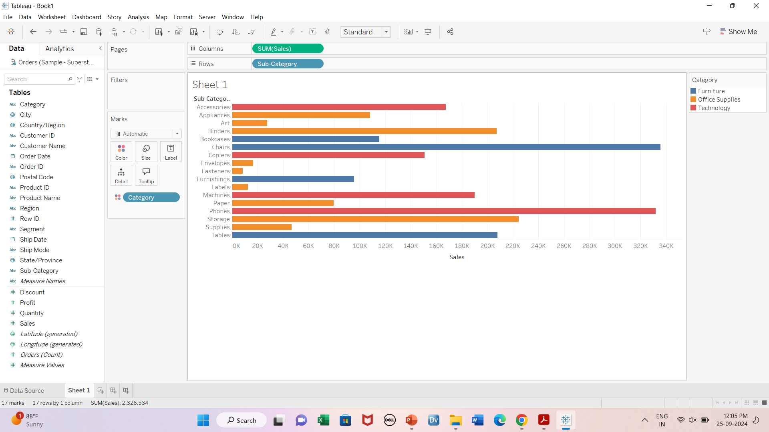
Colors

Slide 9
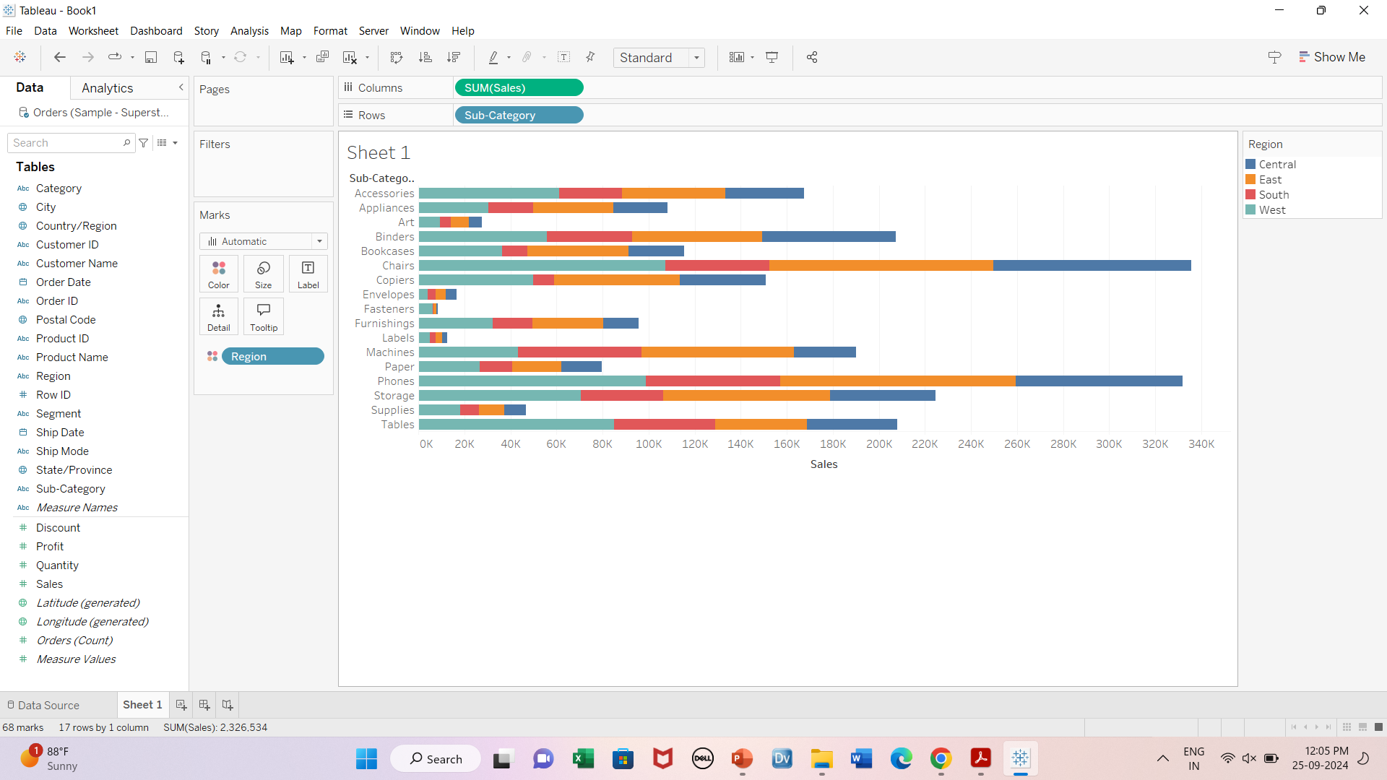
Colors: Bar chart

Slide 10
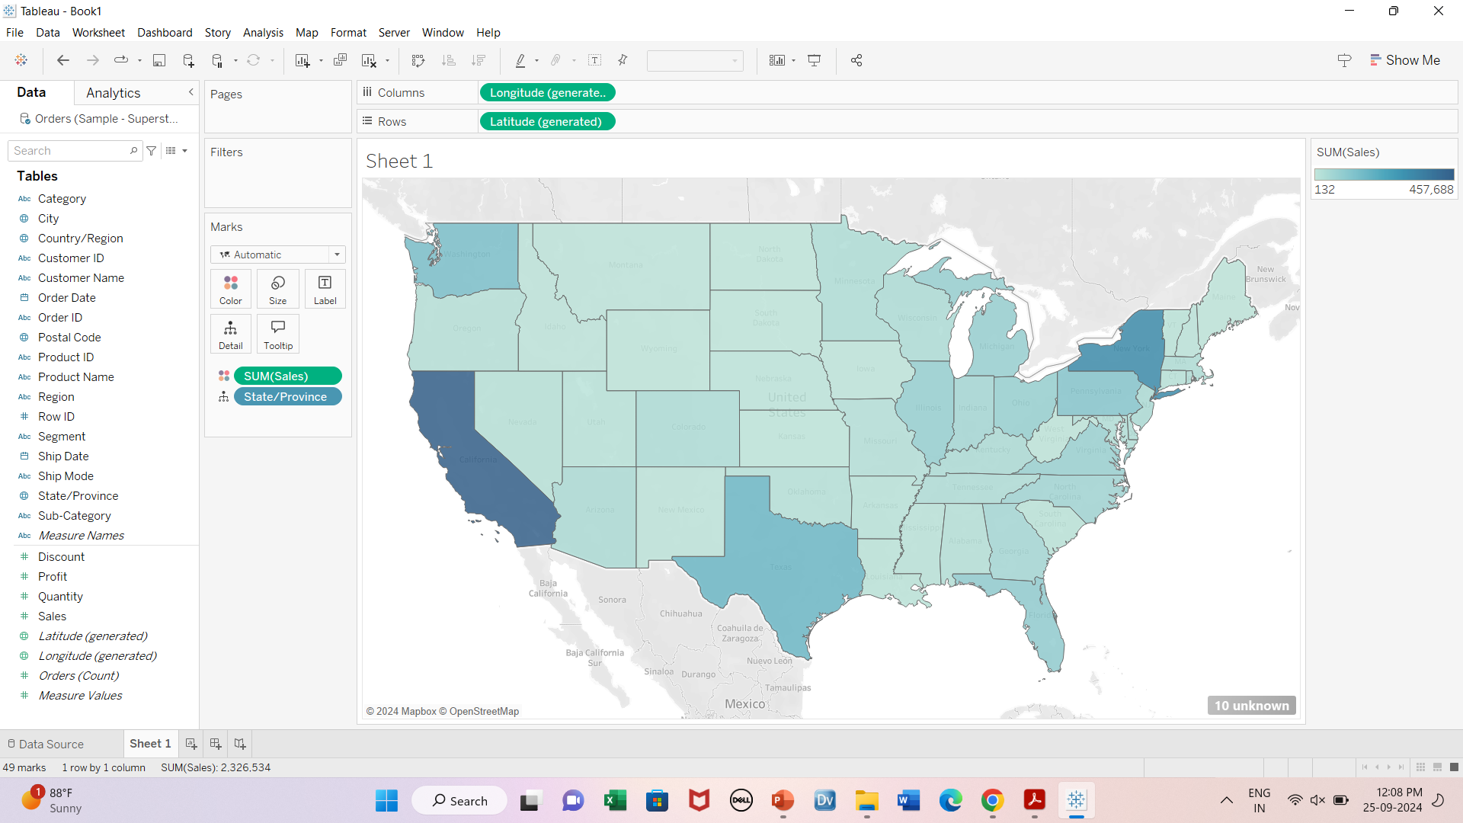
Colors:Map chart

Slide 11
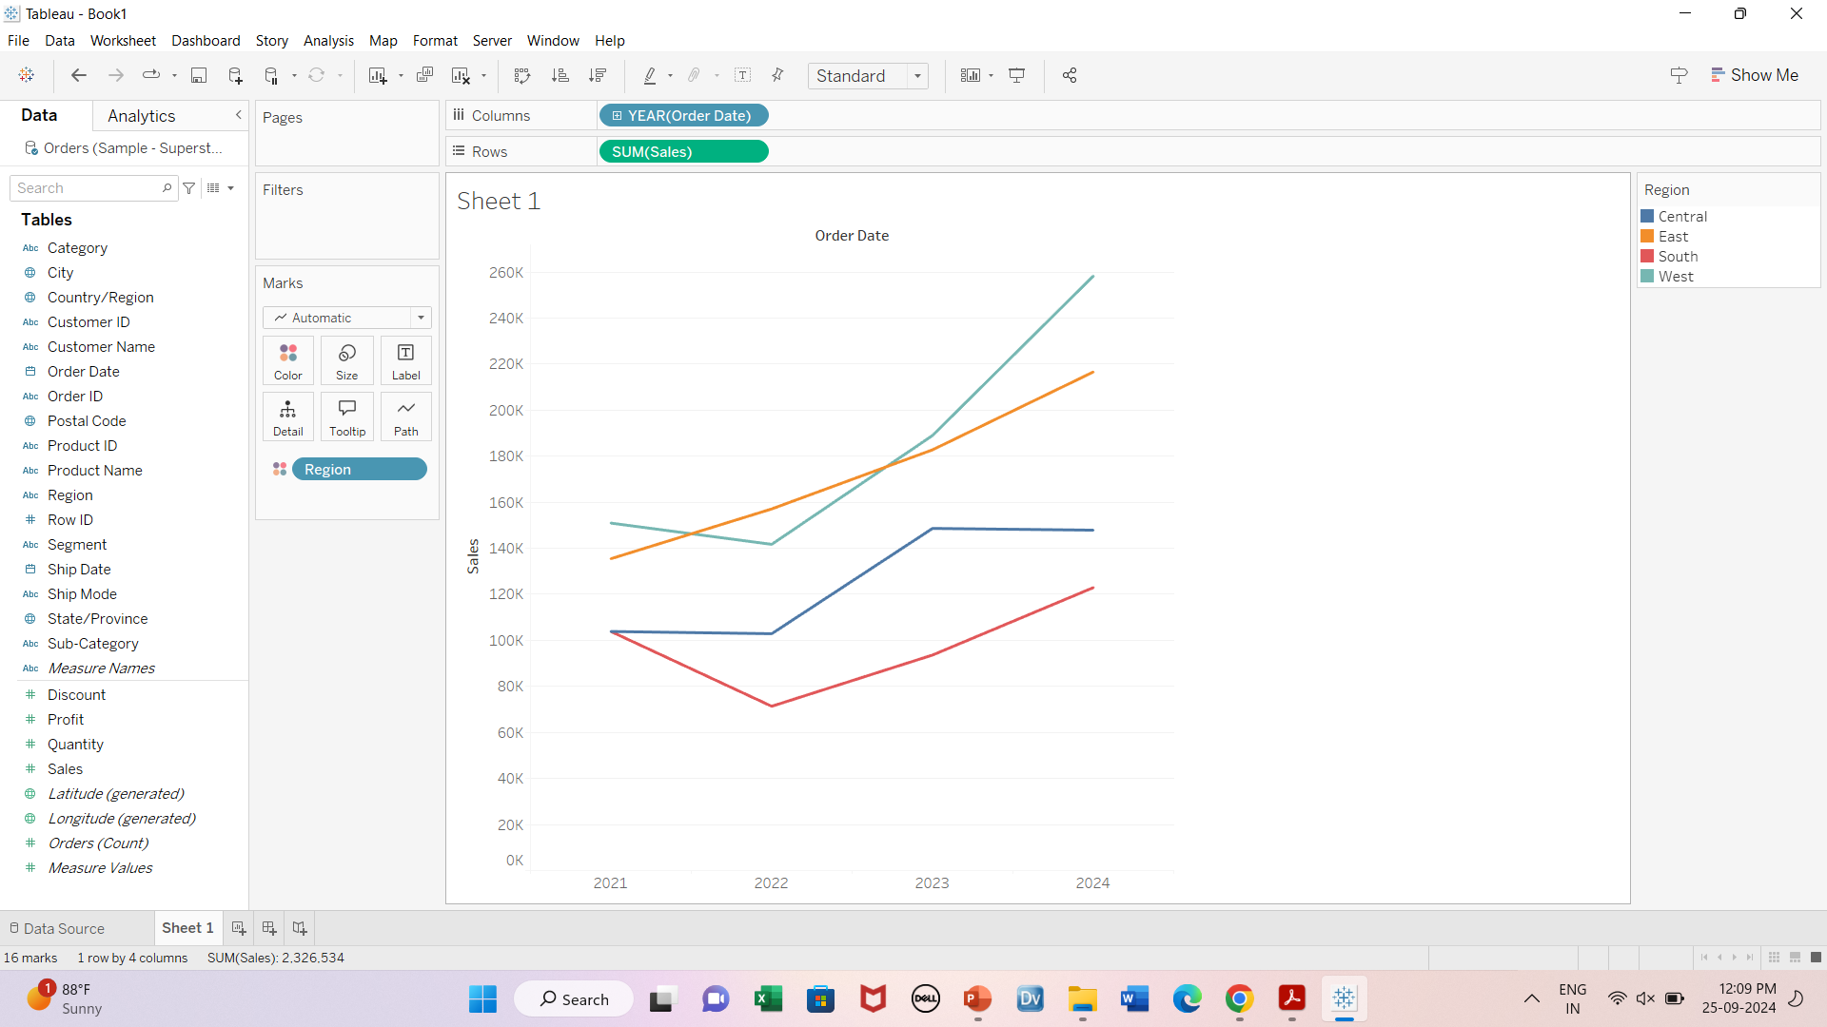
Colors: Line chart

Slide 12
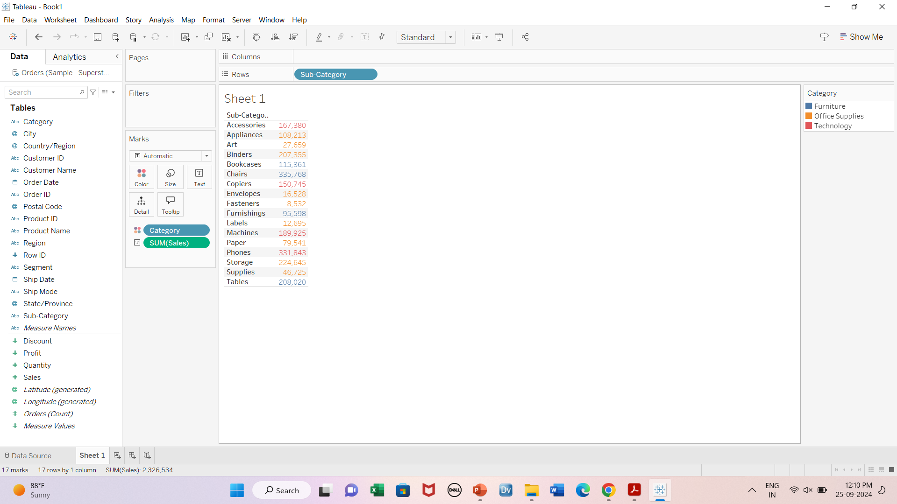
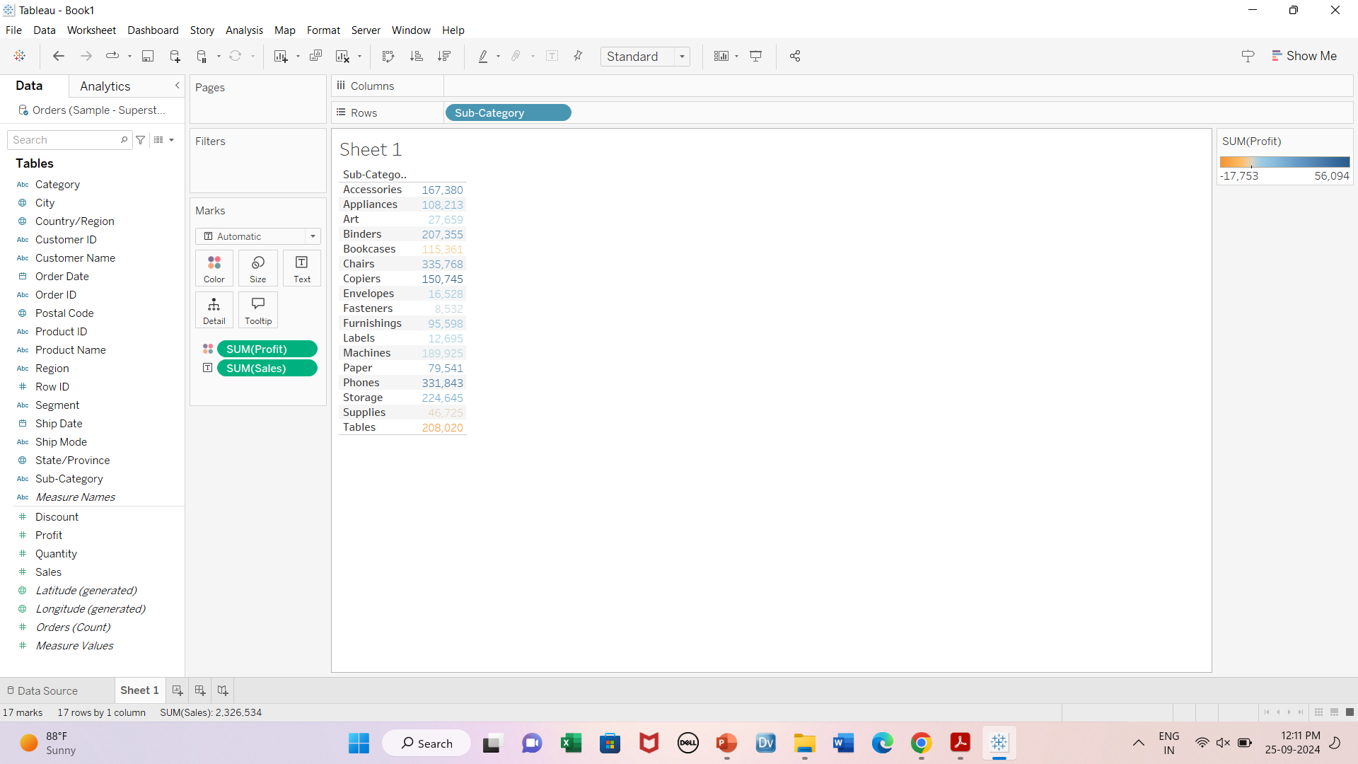
Colors: Tables

Slide 13
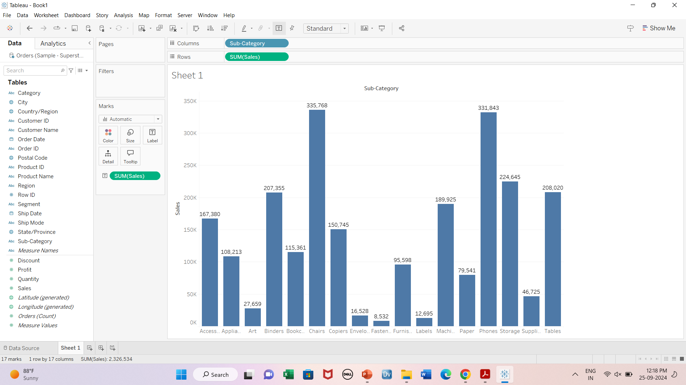
Labels

Slide 14
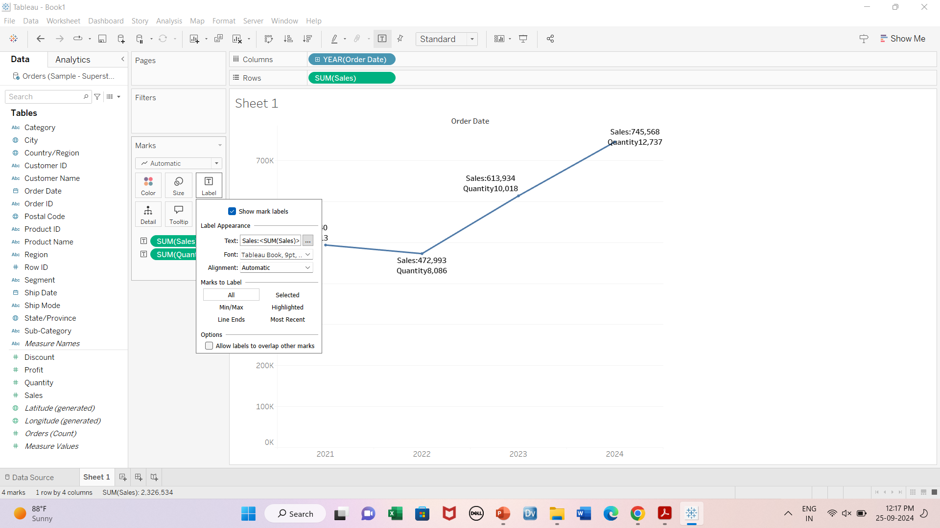

Multiple labels, Alignment, Marks to labels

Slide 15
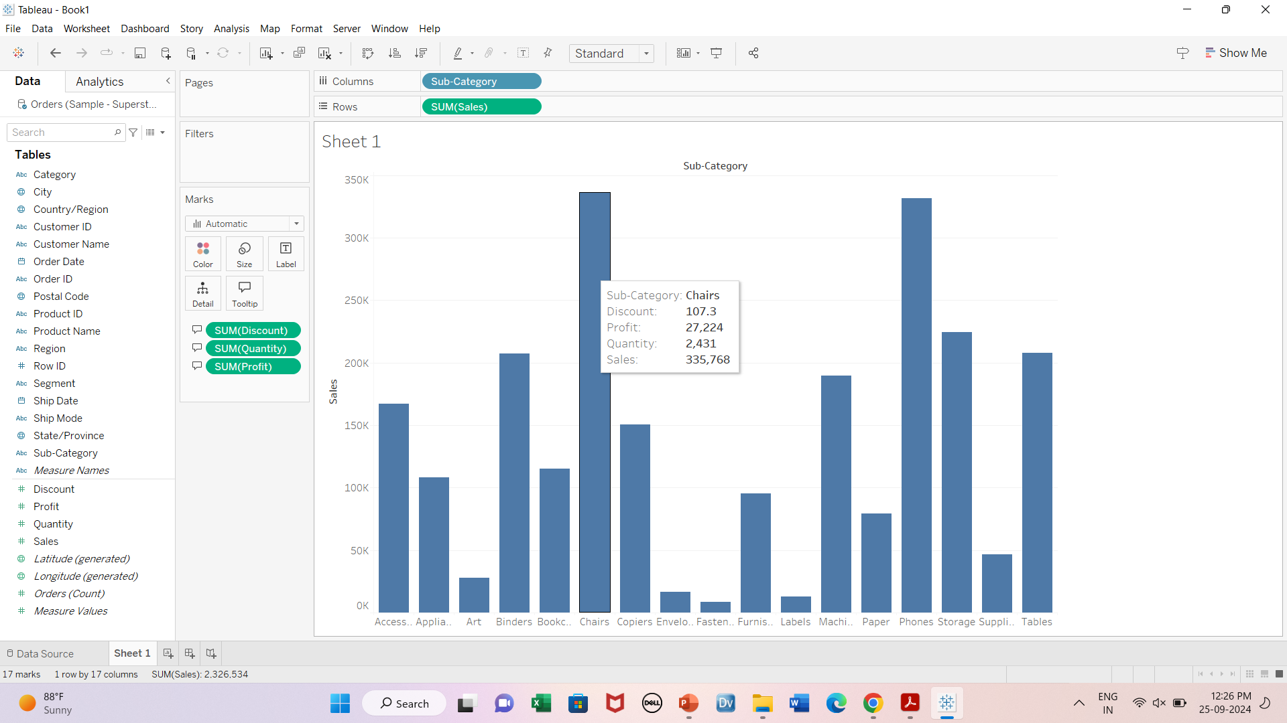

Tooltip

Slide 16
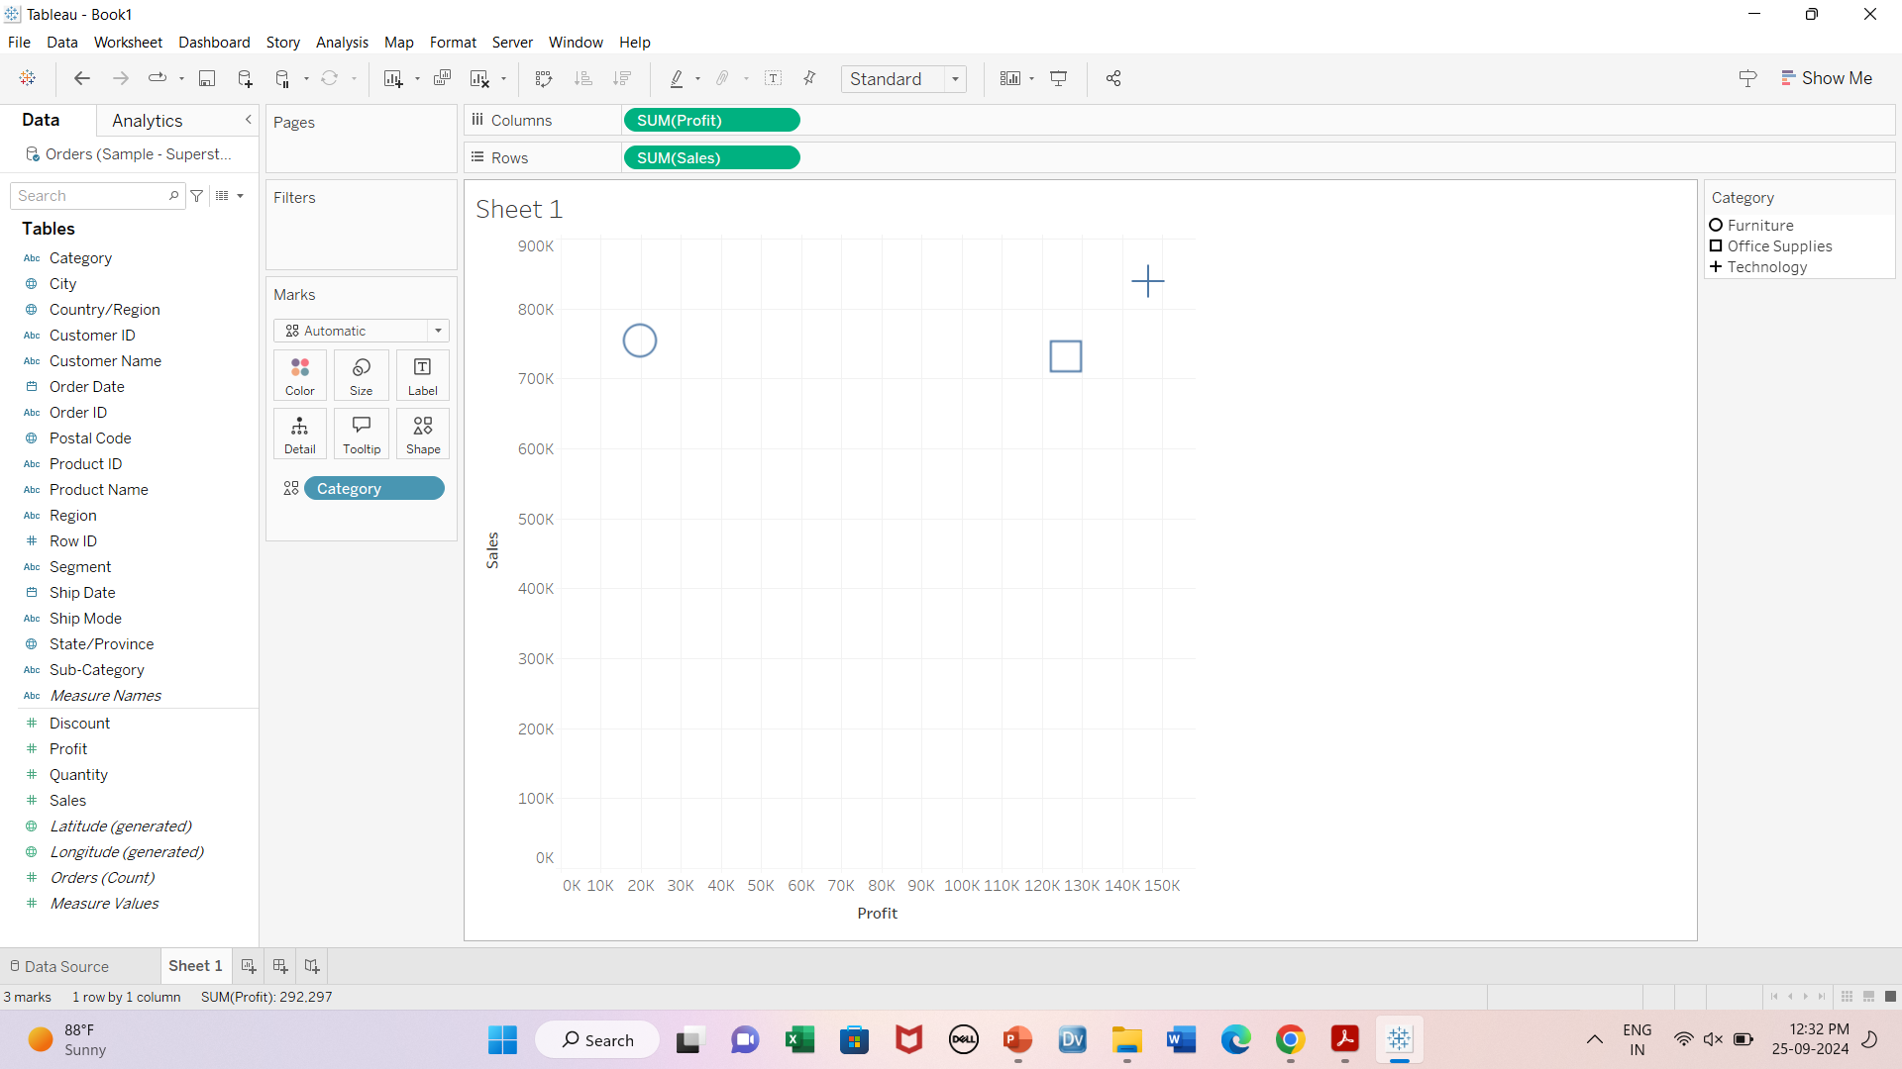
Shapes

Slide 17
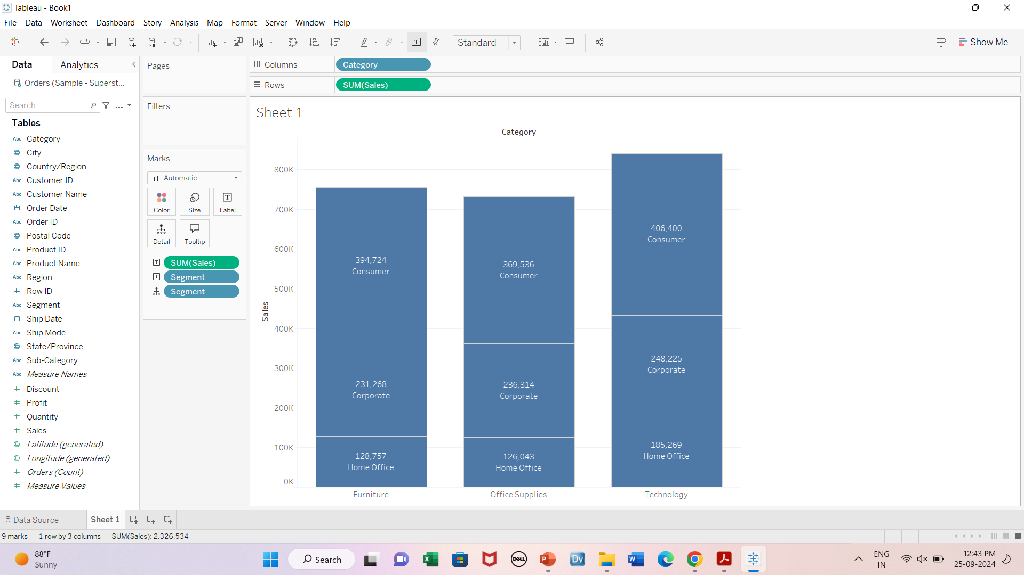
Detail

Slide 18
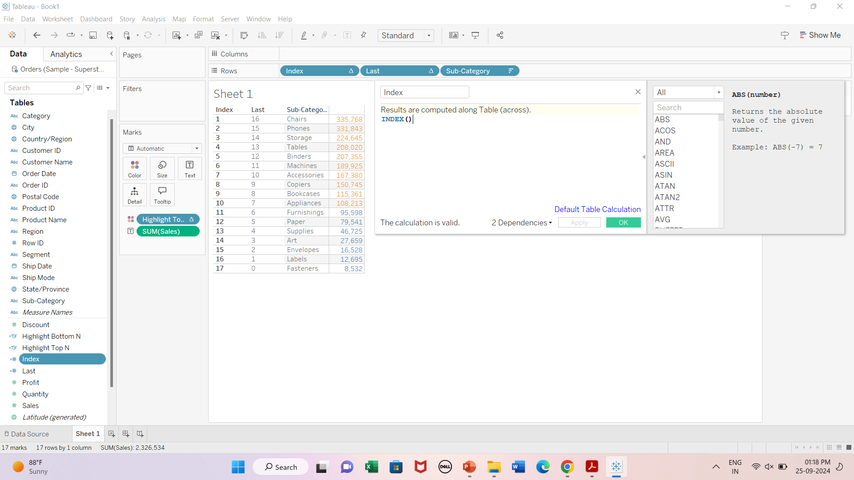
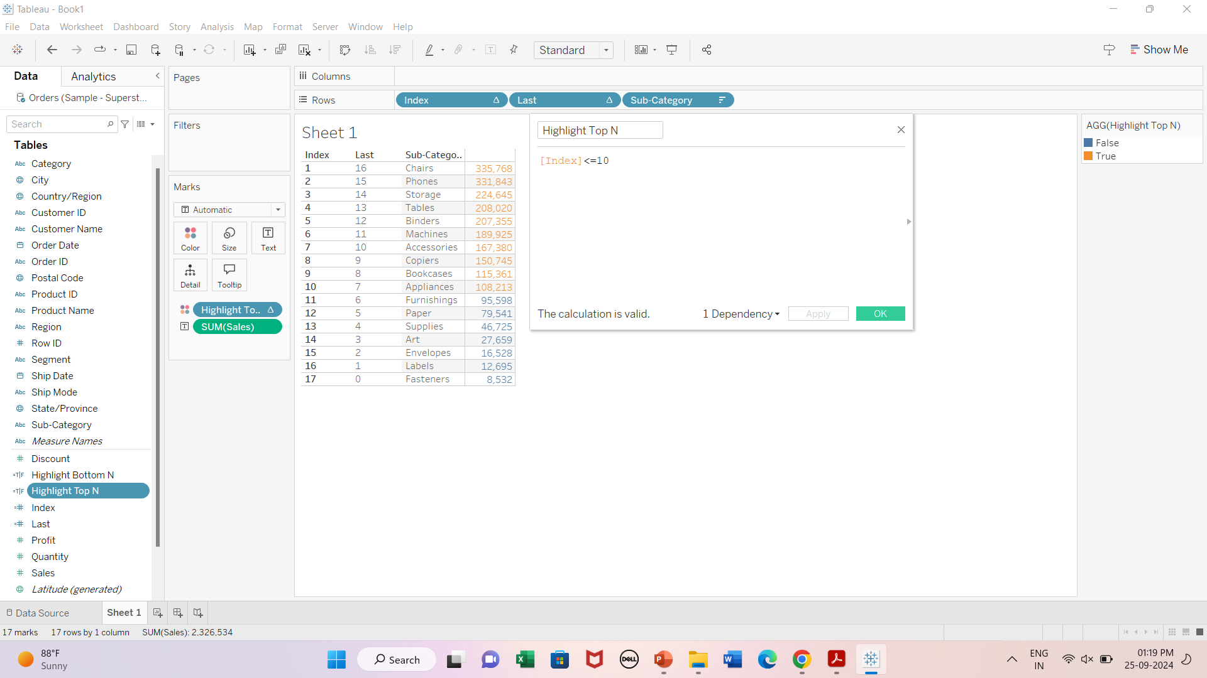
Conditional Formatting
For highlighting Top N values
Create calculated fields
Index
Highlight Top N
Note: Convert Index field from Continuous to discrete

Slide 19
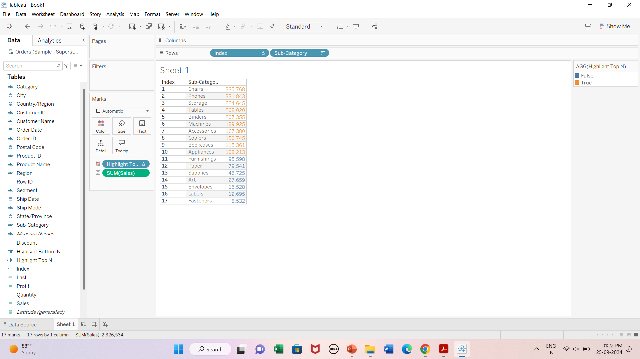

Slide 20
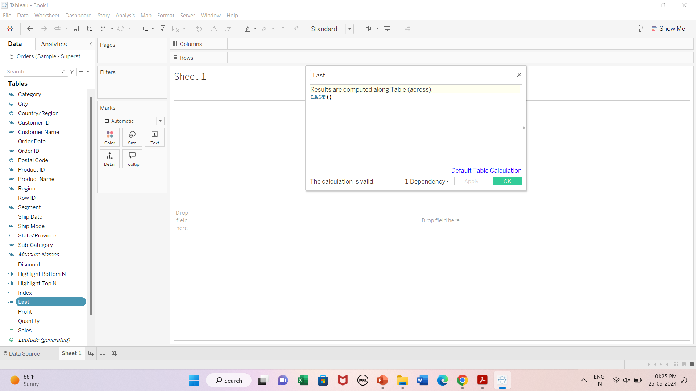
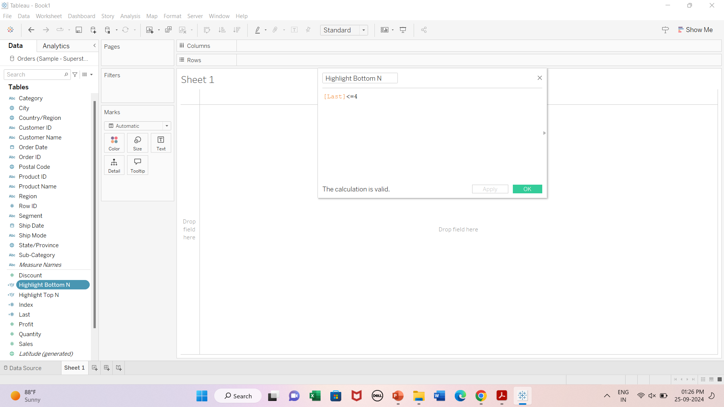
For highlighting Bottom N values
Create calculated fields
Last
Highlight Bottom N
Note: Convert Last field from Continuous to discrete

Slide 21
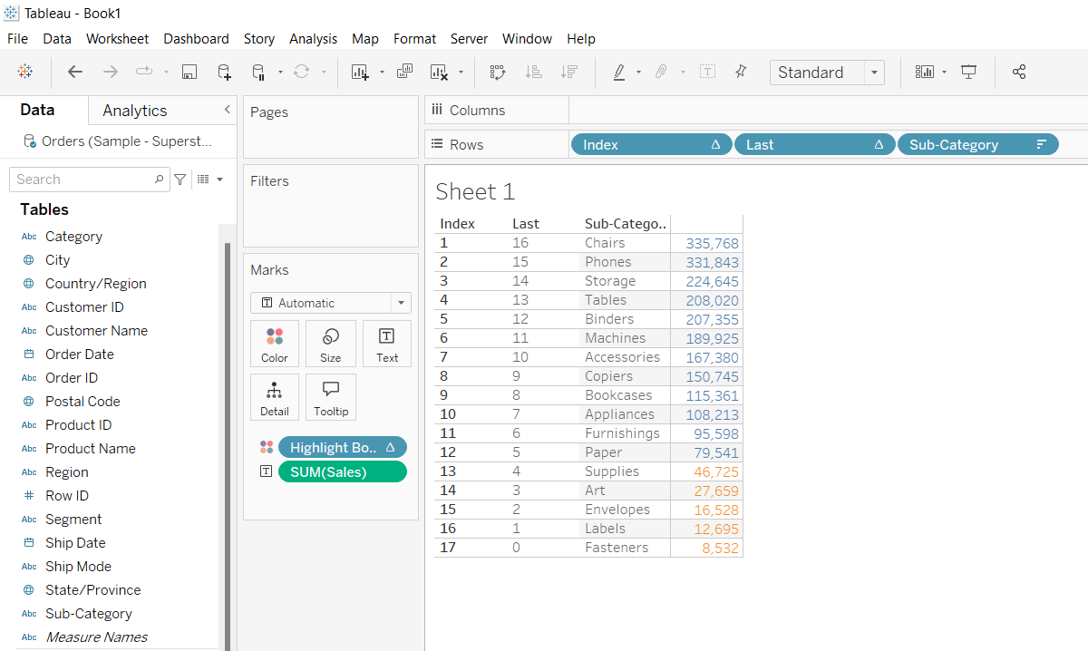

Slide 22
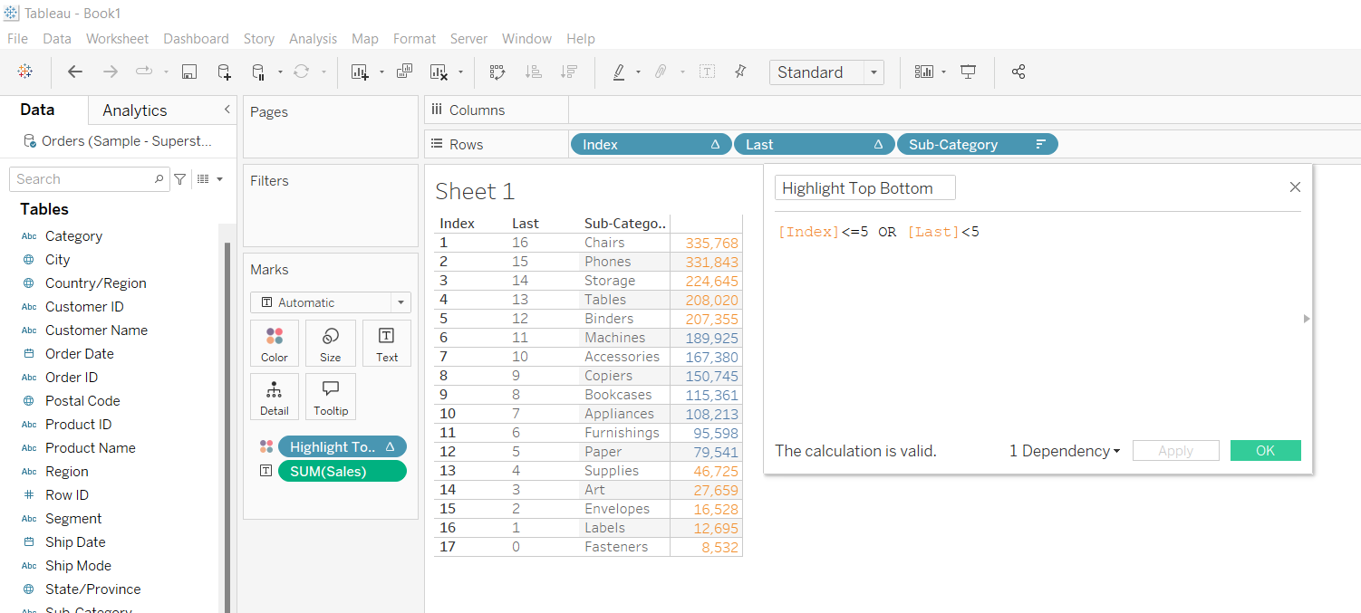
Highlight Top 5 and Bottom 5

